Slide 1
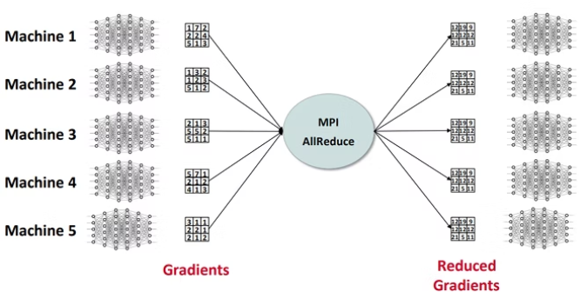
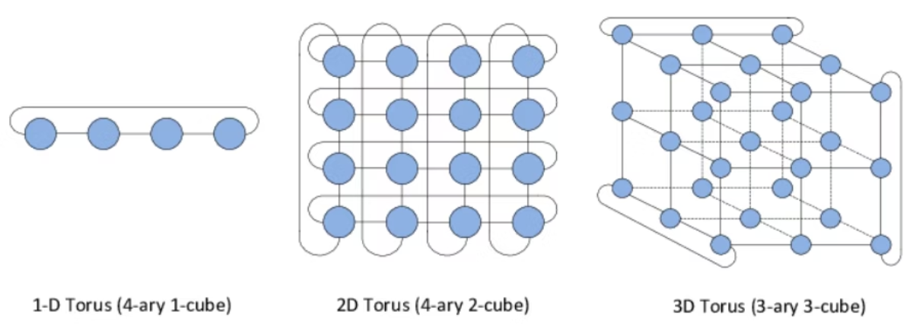

Swing: Short-cutting Rings for Higher Bandwidth AllReduce
Distributed training, particularly AllReduce operations, significantly impacts total training time:
Consumes up to 40% of the entire training duration.
Accounts for 19-30% of total MPI job hours.
All Reduce is a critical bottleneck in high-performance computing (HPC) environments.
Key optimization factors include:
Minimizing physical distance between communicating nodes.
Considering the number of nodes.
Physical topology.
Communication steps.
Bytes per step.
Our innovative "Swing" algorithm aims to overcome these limitations and achieve higher bandwidth.
Presented by:
Jayant Sharma IMT2023523 Garv Rajput IMT2023505 Nirbhay Sharma IMT2023103 Kavya Gupta IMT2023016 Aishwarya Sharma IMT2023515
https://mug.mvapich.cse.ohio-state.edu/static/media/mug/presentations/21/mug21-dl-ml-v3.pdf
https://www.researchgate.net/figure/Examples-of-1D-2D-3D-Torus-topologies_fig1_283100278

Slide 2
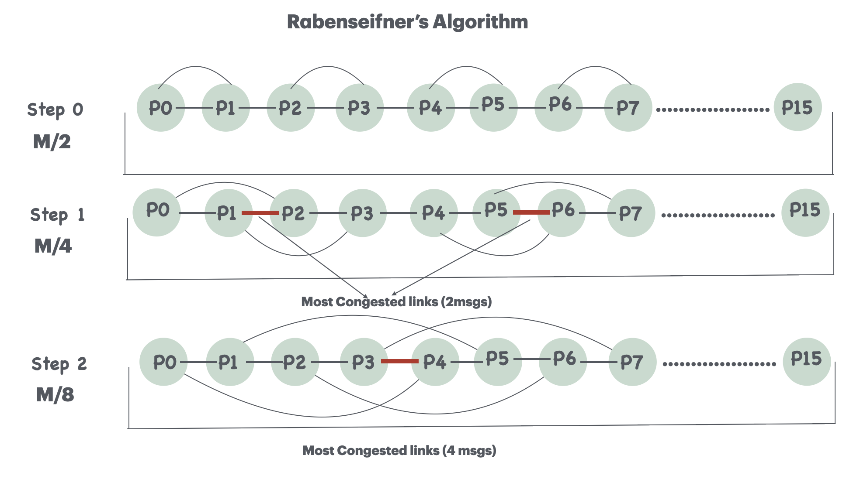

Slide 3
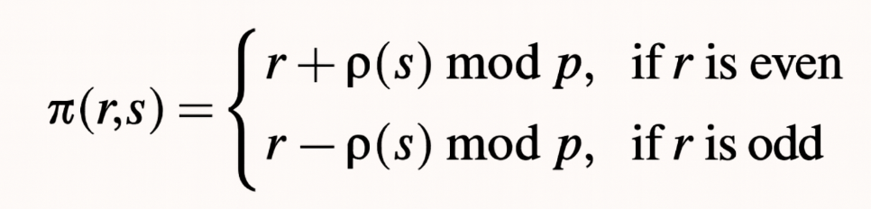
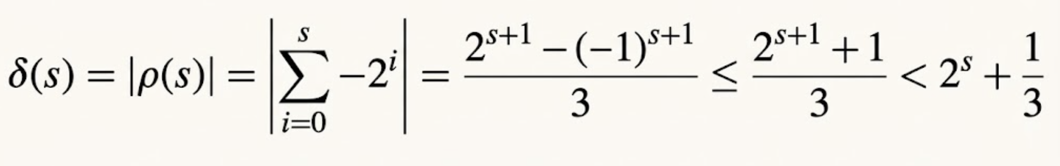

Introducing Swing: A Novel AllReduce Solution
The Solution: Swing
Swing minimizes the distance between communicating nodes by dynamically adjusting communication directions (swinging) across torus dimensions. This innovative approach enhances efficiency by short-cutting traditional ring paths.
The Algorithm:
The Swing algorithm operates in two phases: a reduce-scatter followed by an allgather. In the reduce-scatter phase, at each step 's' (starting from 0), each node 'r' communicates with a node π(r,s) defined by the following formula:
Where:
This unique communication pattern ensures efficient data distribution while keeping communication distances minimal.

Slide 4
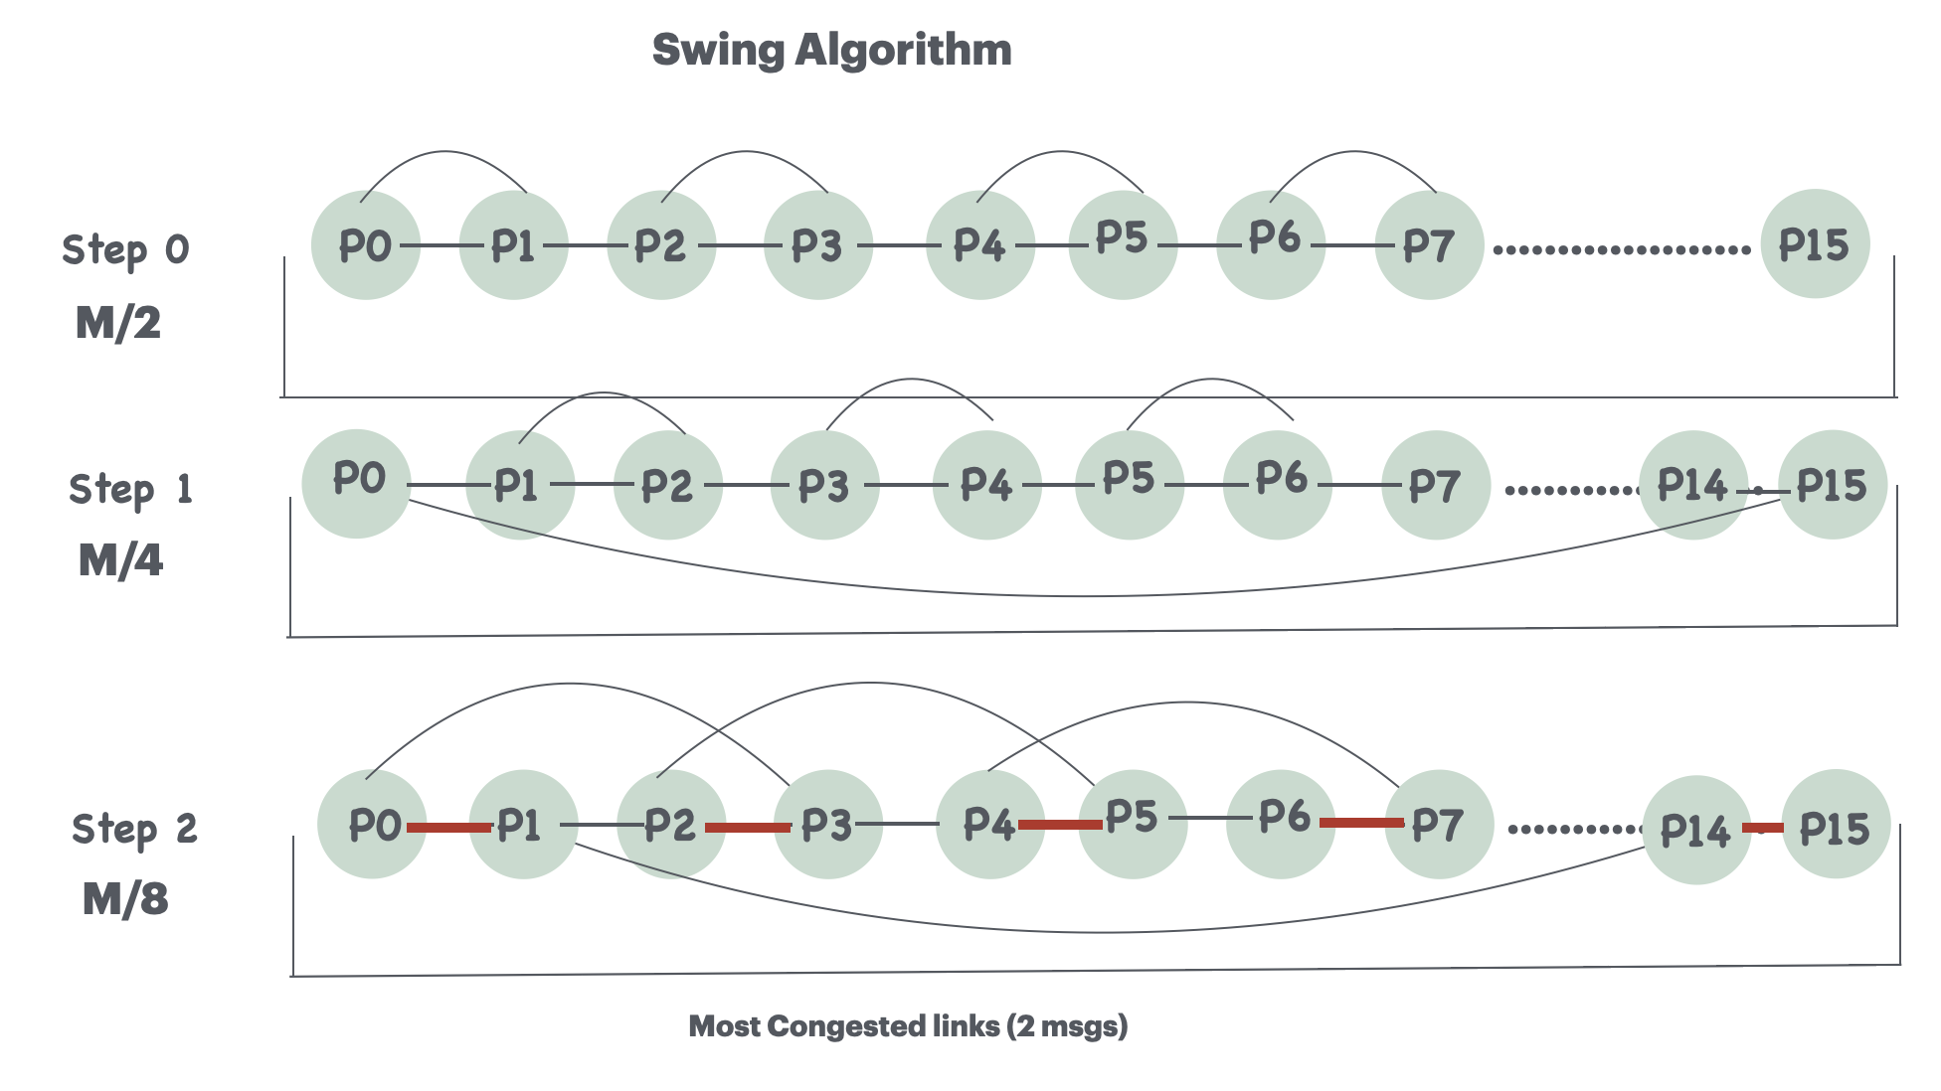

Slide 5



Understanding AllReduce Time Bottlenecks
Latency Deficiency
Bandwidth Deficiency
Congestion Deficiency
Measures the number of extra communication steps an algorithm takes compared to the theoretical optimal of log₂p steps.
Quantifies the amount of additional data transmitted beyond the optimal requirement.
Indicates bandwidth slowdown caused by multiple messages sharing the same physical link.
Assumptions for Analysis:
Ranks are mapped linearly to nodes, with one process (rank) per node.
Each node possesses 2*D ports (where D is dimension).
All communication links are bidirectional.
Network forwards packets using minimal adaptive routing.
Network hardware does not natively accelerate collective operations.
Our goal for an optimal algorithm is to achieve latency, bandwidth, and congestion deficiencies all approaching 1.

Slide 6
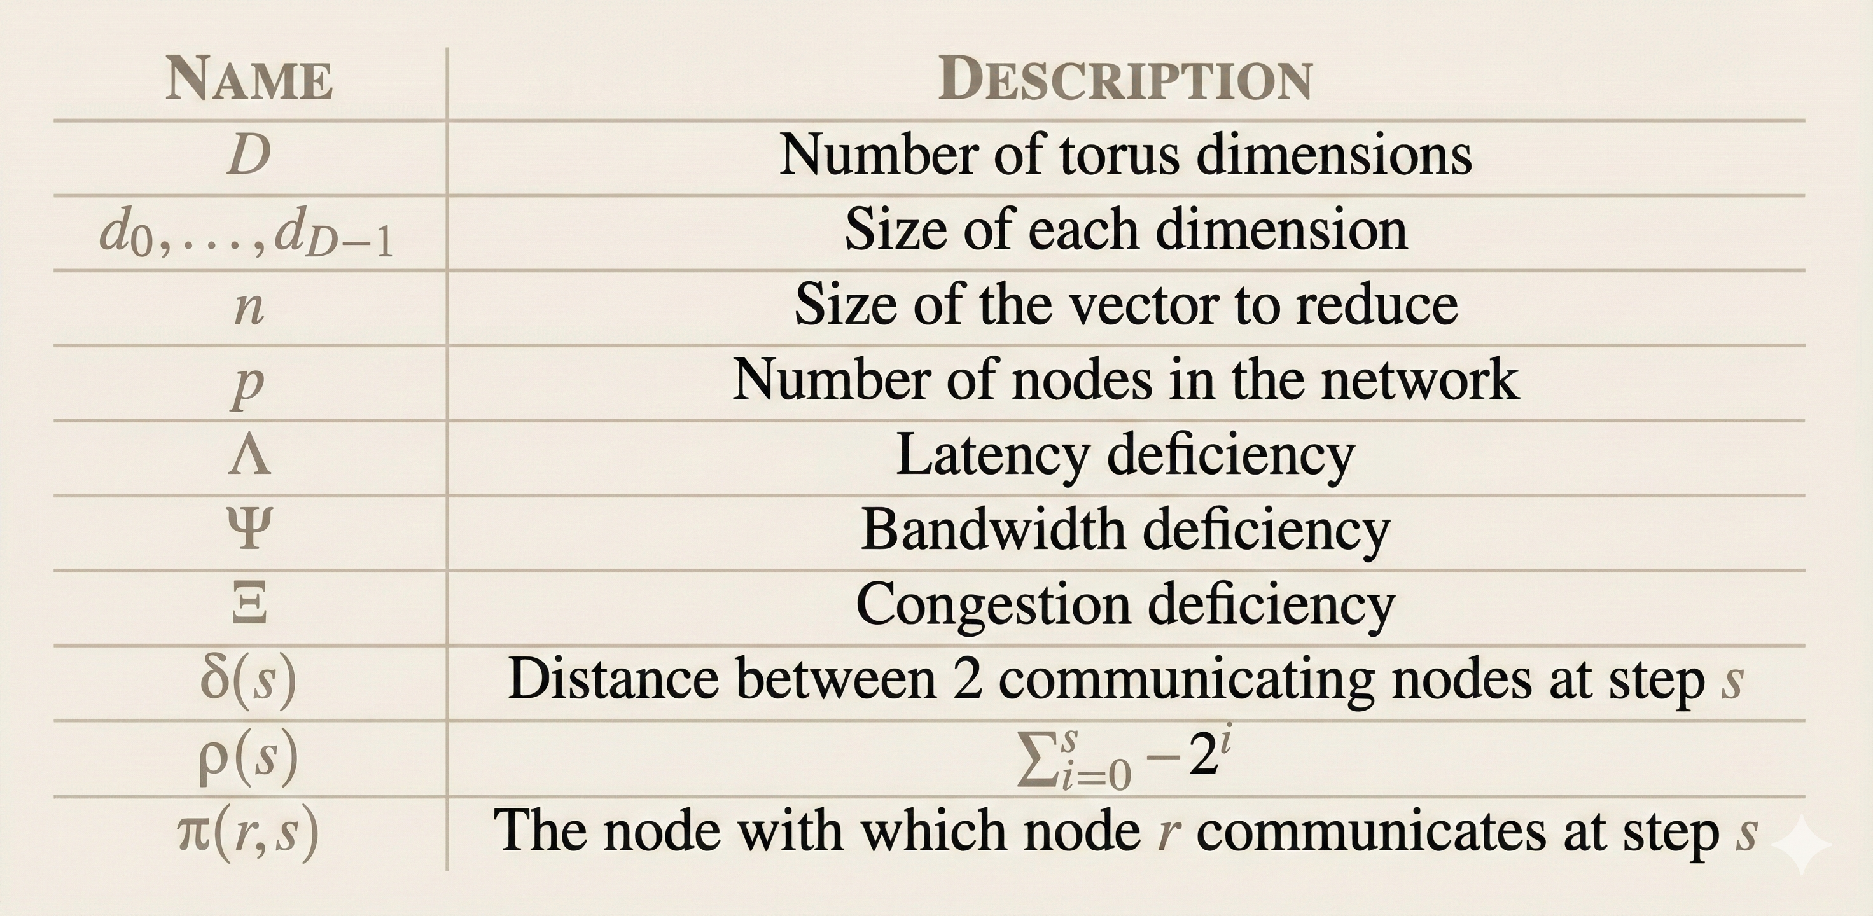
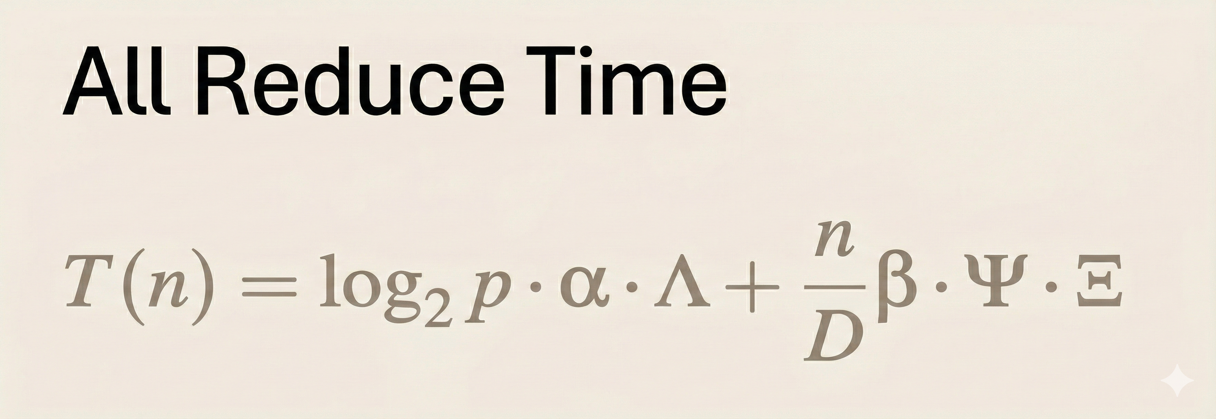
Understanding AllReduce Time Bottlenecks
Goal for an optimal algorithm: Latency Deficiency~1 Bandwidth Deficiency~1 CongestionDeficiency~1​

Slide 7
Swing's Advantages: Optimal Bandwidth and Latency
Bandwidth Optimal
Latency Optimal
Each step involves peers swinging from left to right and vice versa, covering the network efficiently.
Nodes reach distant peers in fewer hops due to the swinging communication pattern.
δ(s) is always a natural number, ensuring lower congestion than recursive doubling.
Because δ(s) is always a natural number, we have δ(s) ≤ 2^{s} (it is strictly smaller for s > 1).Hence, Swing has a lower congestion deficiency than recursive-doubling because of the lower distance between communicating nodes.
Requires only log₂p steps (Λ = 1) and transmits n * log₂p bytes, utilizing all available ports.
The Swing algorithm achieves near-optimal performance in both bandwidth and latency. By dynamically adjusting communication directions, it effectively reduces the physical distance between communicating nodes. This strategic approach significantly lowers congestion deficiency, making Swing highly efficient for large-scale distributed systems.

Slide 8
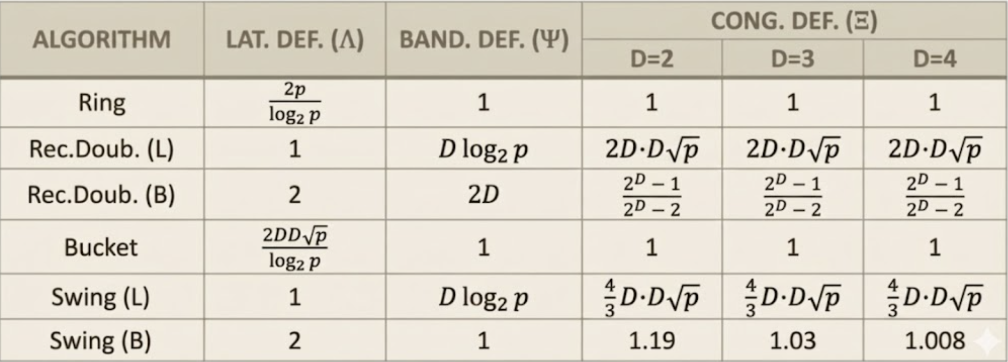
Swing Comparison with other algorithms

Slide 9
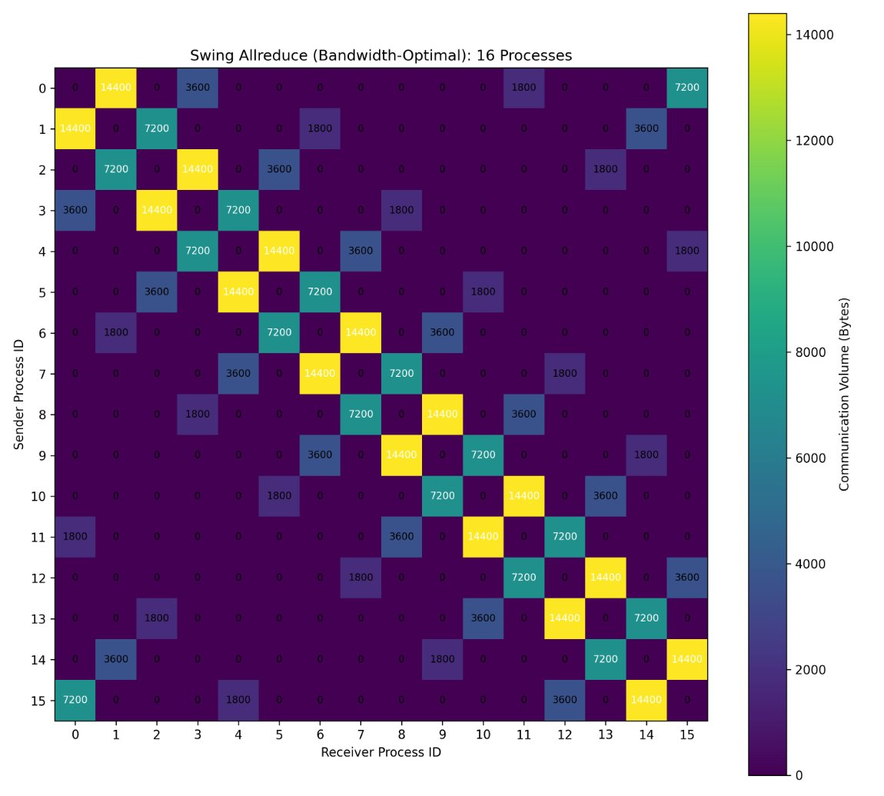

Slide 10
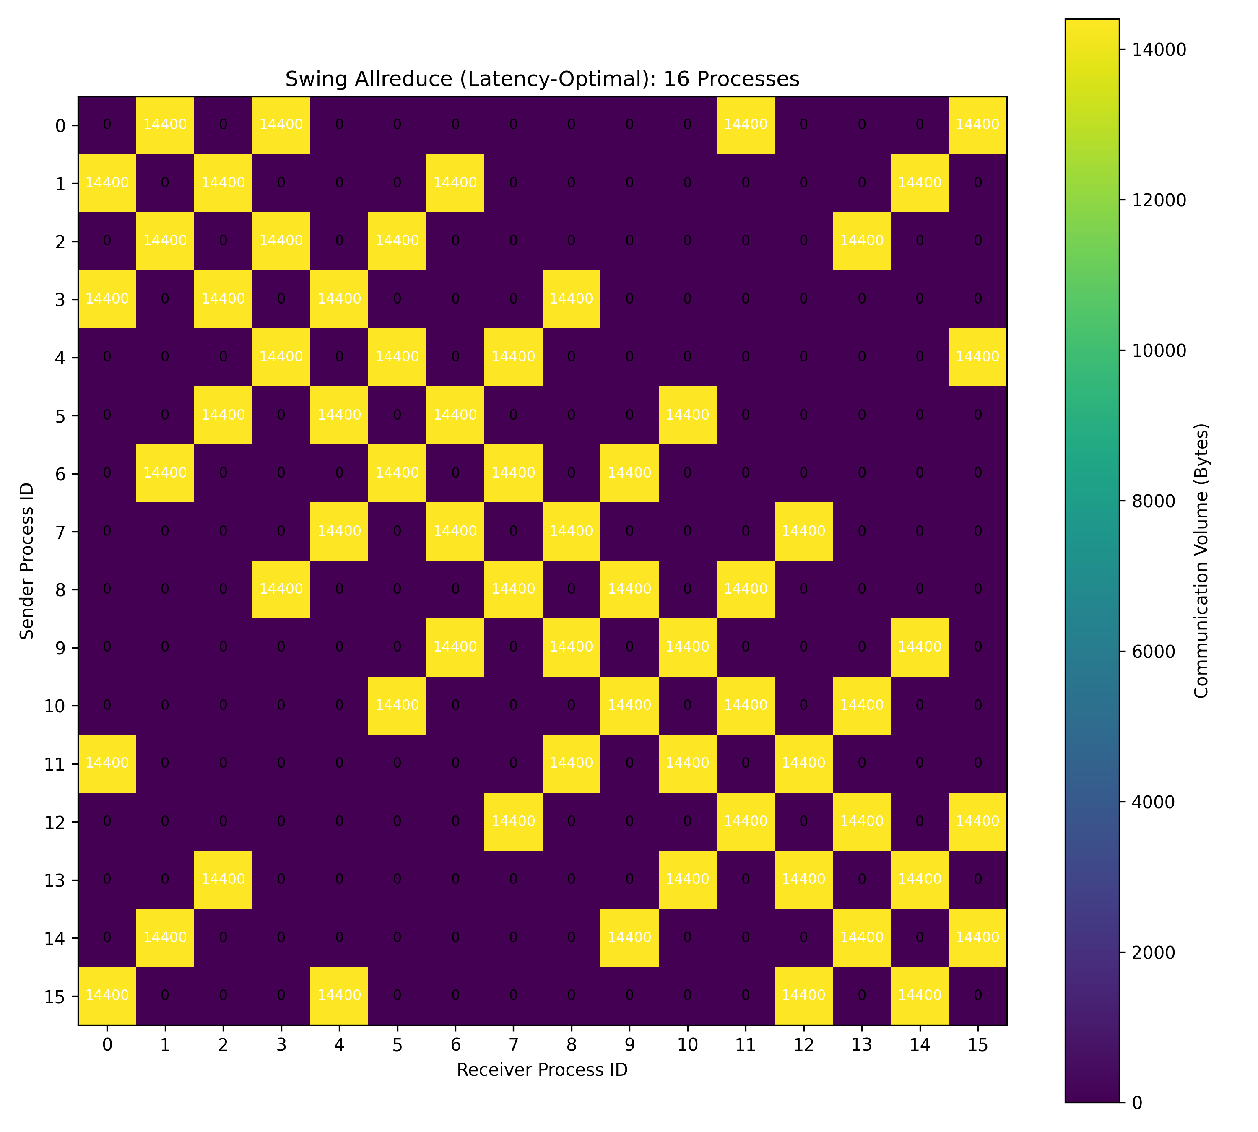

Slide 11
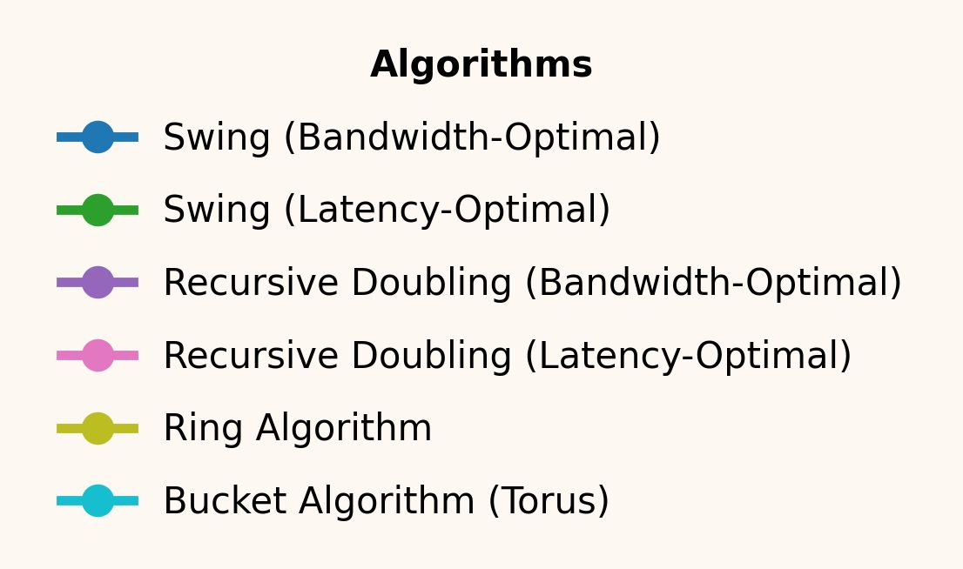
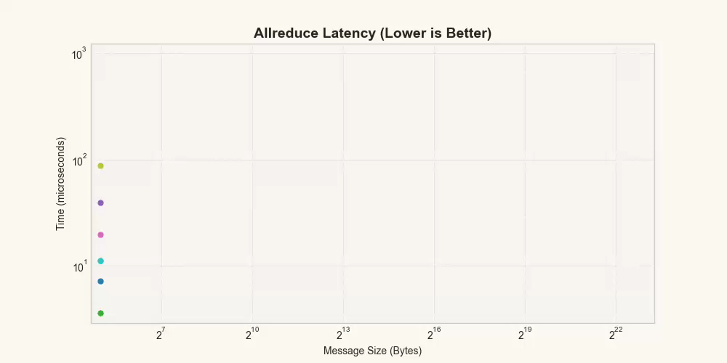
Latency Comparisons for 8x8 Torus

Slide 12
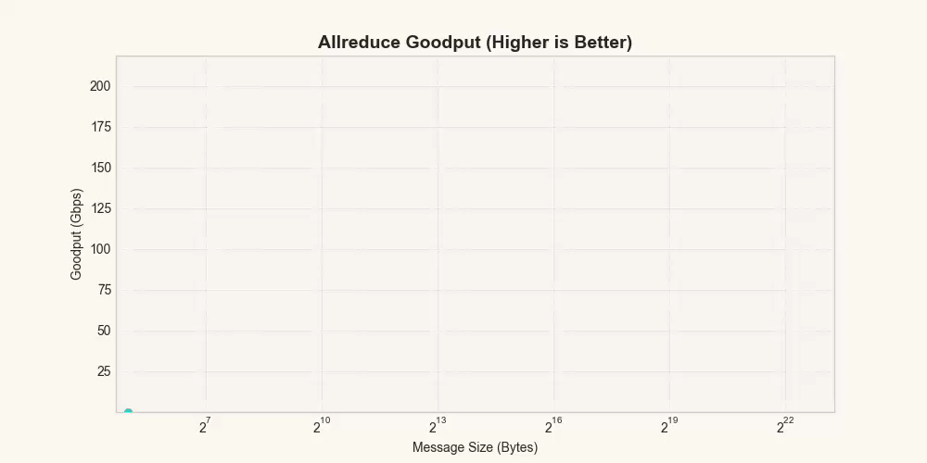
Goodput Comparisons for 8x8 Torus

Slide 13
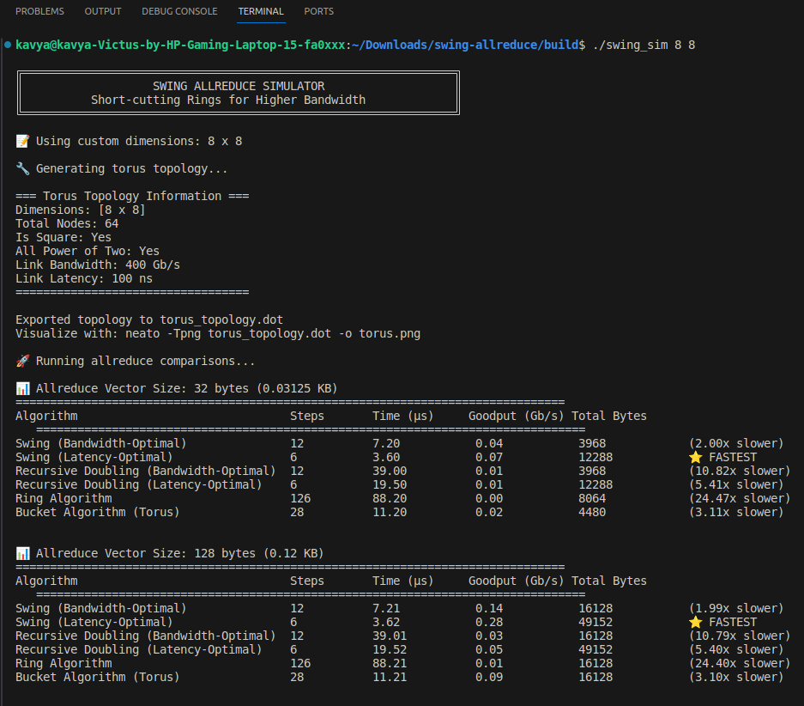
./swing_sim 8 8

Slide 14
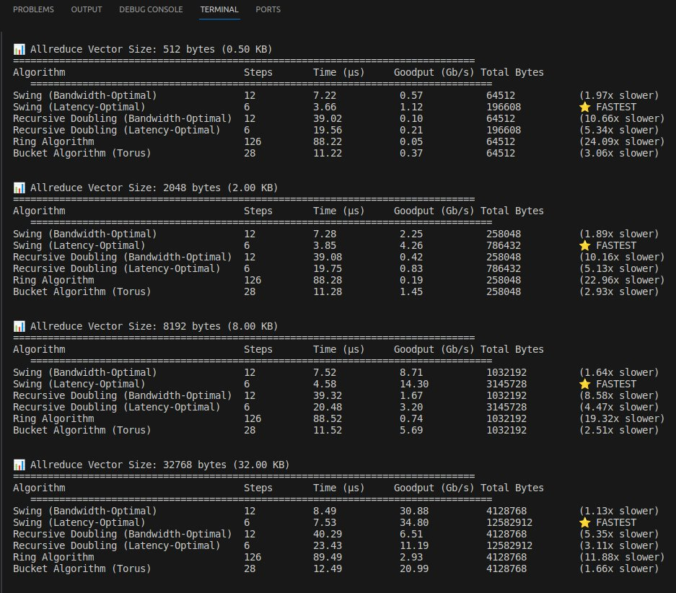

Slide 15
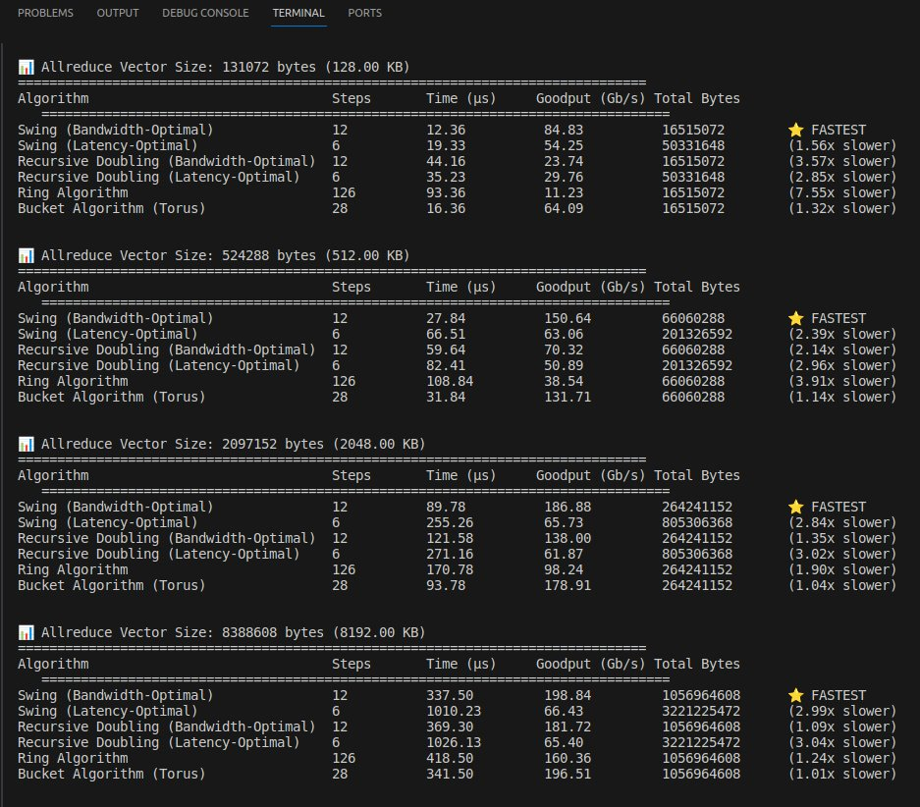

Slide 16
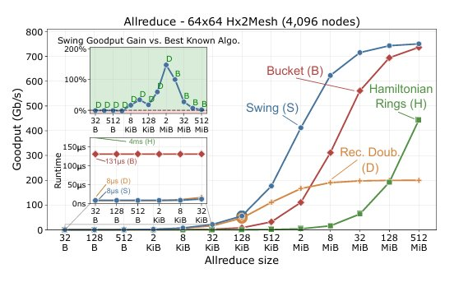
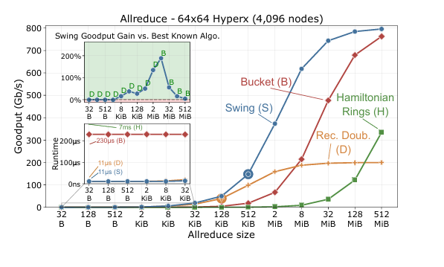
Goodput on a 4,096nodes Hx2Mesh
Goodput on a 4,096nodes HyperX

Slide 17
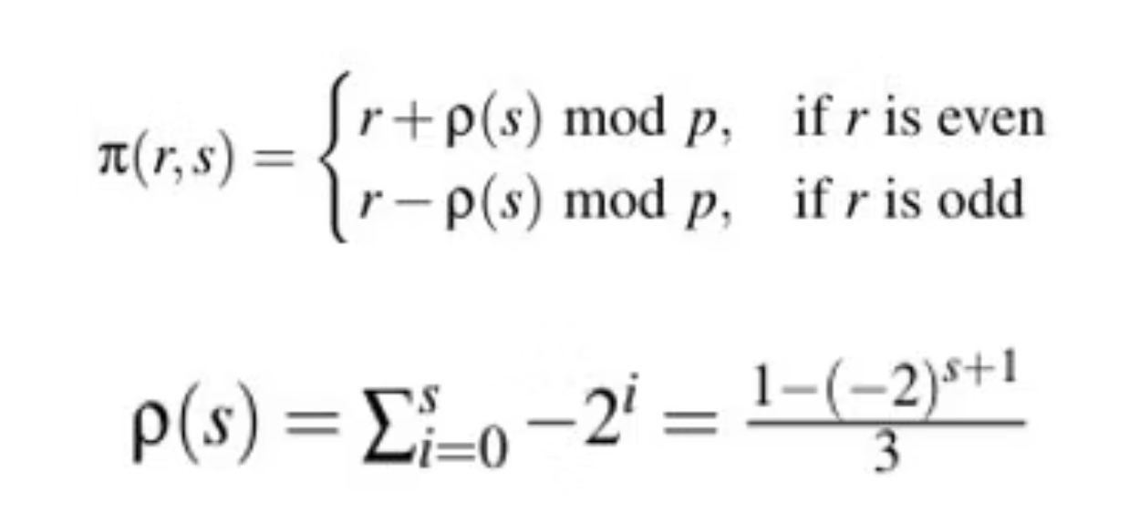
Mathematical Correctness: Zero Redundancy
The Mathematical Foundation
The Challenge: Since Swing oscillates directions (Left/Right) instead of expanding monotonically, ensuring every node receives every data chunk exactly once is crucial.
How can we guarantee that we don't accidentally revisit a node and waste bandwidth sending data they already have?
Key Insight: The "Swing" distance function generates a unique sequence of hops that covers the entire ring of size P in exactly log₂P steps.
Results
Generates Unique Hop Sequence
The algorithm guarantees Zero Redundancy. No bandwidth is wasted sending data to a node that already possesses it.
Total steps remain logarithmic, maintaining optimal latency deficiency = 1.
For Formal Mathematical Proof, refer to Appendix A in the full paper: Swing NSDI Paper https://htor.inf.ethz.ch/publications/img/2024_Swing_NSDI_Paper.pdf

Slide 18
Lemmas Required for Proof
Lemma A.1:
ρ(s) are odd for all s <- N.
Lemma A.2:
If r is even, δ(s,r) is odd, and vice versa.
Lemma A.3:
Even nodes reach odd nodes through an odd number of steps k. Odd nodes reach even nodes through an odd number of steps k/
Lemma A.4:
Given k integers {e0 < e1 < . . . < ek−1}, with ek−1 ≤ log2(p)−1, then −p < Σk−1 i=0 (−2)ei < p.
Theorem A.5:
On a 1D torus, if a node r at step s communicates with node π(r, s) (defined in Eq. 2), it will reach (directly or indirectly) all the other p−1 nodes in log2(p) steps (with p power of two).
The proof uses a contradiction argument based on the unique representation of integers in base -2. Just as every number has a unique binary representation, the paper proves that
for any target node q, there is one and only one sequence of hops that can reach it. Therefore, we can mathematically guarantee that in exactly log_2(p) steps, every node reaches
every other node exactly once, with zero redundancy.

Slide 19
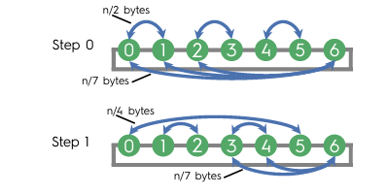
Handling Real-World Edge Cases: Non-Power-of-Two Nodes
Real supercomputers often encounter scenarios with failed nodes or odd configurations (e.g., 63 active nodes).
Swing demonstrates robustness in these situations, outperforming padding strategies.
The Problem:
Most collective algorithms assume P = 2^k, limiting flexibility.
Standard solutions involve padding with "dummy" nodes, which wastes bandwidth and compute cycles.
Swing Strategy:
The Proxy Mechanism:
Retrieval:
If P is odd, Swing runs the standard algorithm on P-1 nodes (the largest even subset).
The leftover node (P_last) splits its data vector and distributes it among the even group before the main algorithm begins.
Once the even group completes its operations, P_last retrieves the reduced results from its peers.
Performance Impact:
This approach adds a negligible additive factor of 1/P to the bandwidth deficiency. Swing maintains its low congestion properties even in these complex edge cases, ensuring efficient operation.

Slide 20
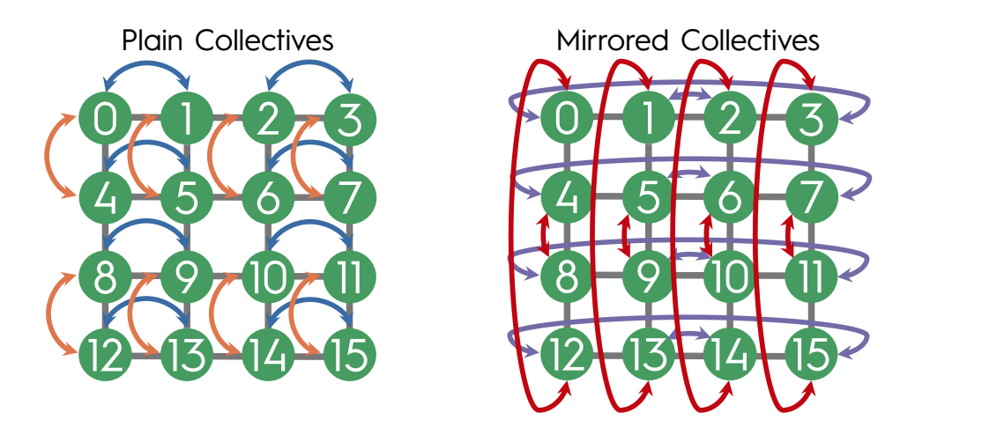
Real-World Scaling: Multi-Dimensional & Rectangular Tori
Real supercomputers like Fugaku or TPUs utilize 2D/3D grids, not simple 1D lines. Standard 1D algorithms would leave many ports idle, leading to inefficiency. Swing addresses this with Mirrored Collectives.
Mirrored Collectives
Plain vs. Mirrored
Collision Avoidance
To fully utilize all available ports (North, South, East, West), Swing employs mirrored collectives.
A Plain Collective runs the standard Swing pattern (e.g., Horizontal then Vertical). A Mirrored Collective runs the reverse pattern (Vertical then Horizontal) in the opposite direction.
By routing flows in opposite directions, plain and mirrored collectives never compete for the same physical link. This reduces congestion deficiency to almost 1.0 (near optimal) even on complex 3D grids, saturating full bisection bandwidth without collisions.

Slide 21
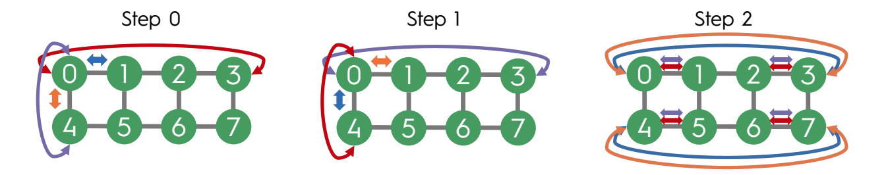
Handling Rectangular Shapes (Non-Square):
Problem
Adaptation
Tradeoff
This approach introduces a slight increase in congestion deficiency due to idle ports in later steps but remains significantly faster than competitors for medium vectors.
In a 2x4 grid, the shorter dimension completes earlier.
Swing runs fully parallel until the shortest dimension (d_min) completes. It then continues as a lower-dimensional torus on the remaining long axes.

